Slide 1
Distributed Control and Automation Framework (DCAF)
DCAF Debugging
Benjamin Celis, Simon Perez Santa Maria

Slide 2
Agenda
RT debugging Challenges
Debugging
Running modules outside of the Engine
Debugging Reentrant Vis.
Debugging tools
Syslog
Tag View
CVT
Shared Variables.

Slide 3
DCAF Temperature Chamber
CRIO Hardware
DCAF Scan Engine Module
DCAF Engine
DCAF UDP Module
UDP
DCAF UDP Module
DCAF Engine
DCAF UI Module
UI VI

Slide 4
RT Debugging Challenges
Complex Systems
Multiple devices
Cant Debug Re-entrant VI in RT
RT system might be running headless
Network Issues
Process Starvation
Timing Issues
Race Conditions

Slide 5
Debugging Core Methodology

Slide 6
Follow Programing Best Practices
The best way to not have a bug is to prevent it in the first place.
Best practices reduce the possibility of bugs to happen and makes it easier to find them once they happen.
Best Practices Include:
Modular code
Unit Testing
Single Writers
Reduce number of global resources.

Slide 7
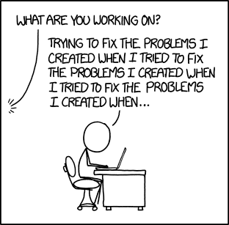
Every Bug has a Cause
Notes:
Search for the root cause
One bug might hide other bugs

Slide 8
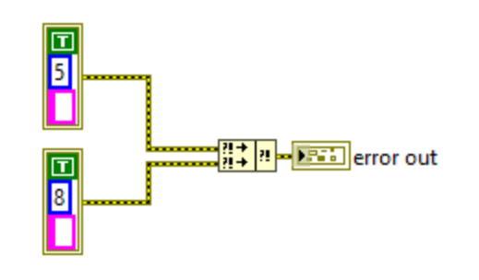
Error Wiring
Error propagation
Merge Error order
Unreported errors
Unwired errors

Slide 9
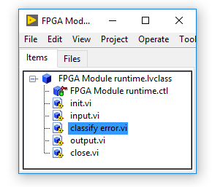
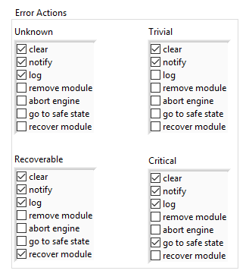
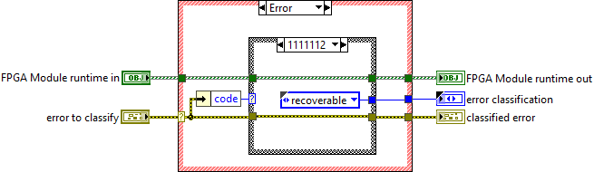
DCAF Error Management

Slide 10
Where is the Bug?
CRIO Hardware
DCAF Scan Engine Module
DCAF UI Module
UI VI
DCAF Engine
DCAF Engine
DCAF UDP Module
UDP
DCAF UDP Module
Notes:
Blaming the engine.
Checking for timing
Binary Search

Slide 11
Hardware Debug Tools

Slide 12
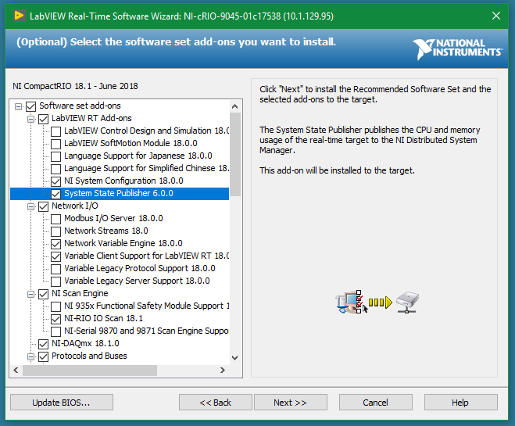
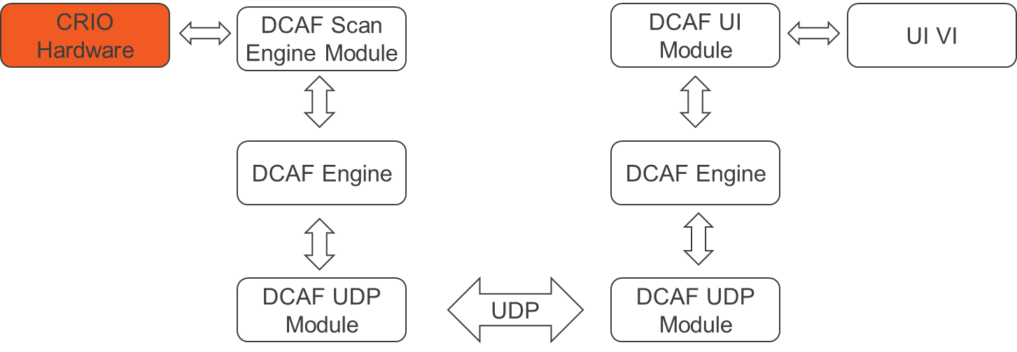
Distributed System Manager

Slide 13
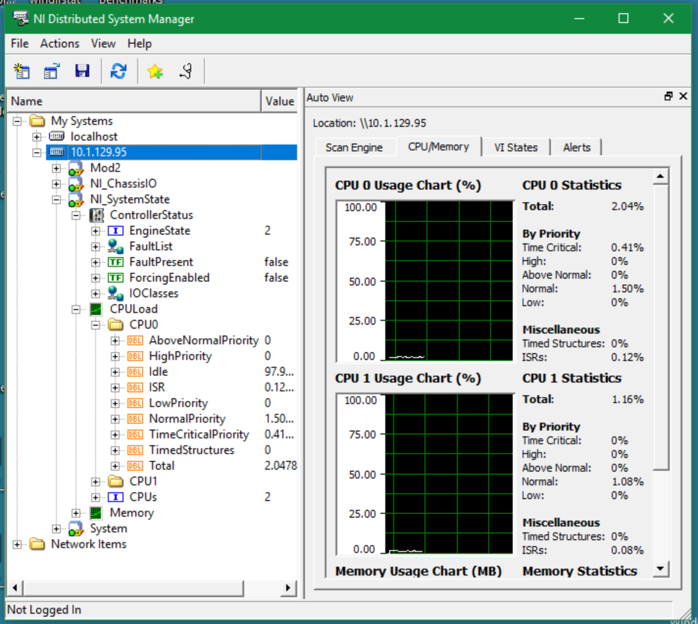
Distributed System Manager

Slide 14
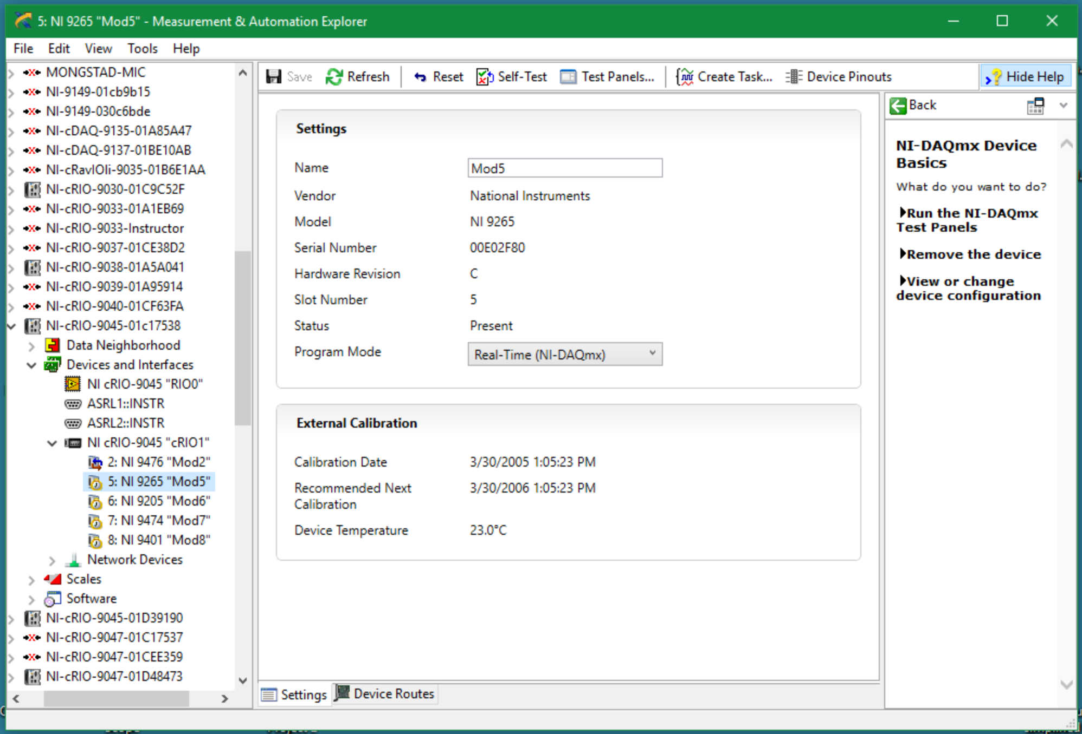
Max

Slide 15
LEDs and Loop Backs
Check for “Loose Wires”
Some Modules have LEDs
The CRIO has User LEDS
Make Loopbacks in the modules

Slide 16
Hardware Debug Tools

Slide 17
Basic Debug
Breakpoints
Probes
Conditional Probes
Hold Error Wire
Highlight Execution

Slide 18
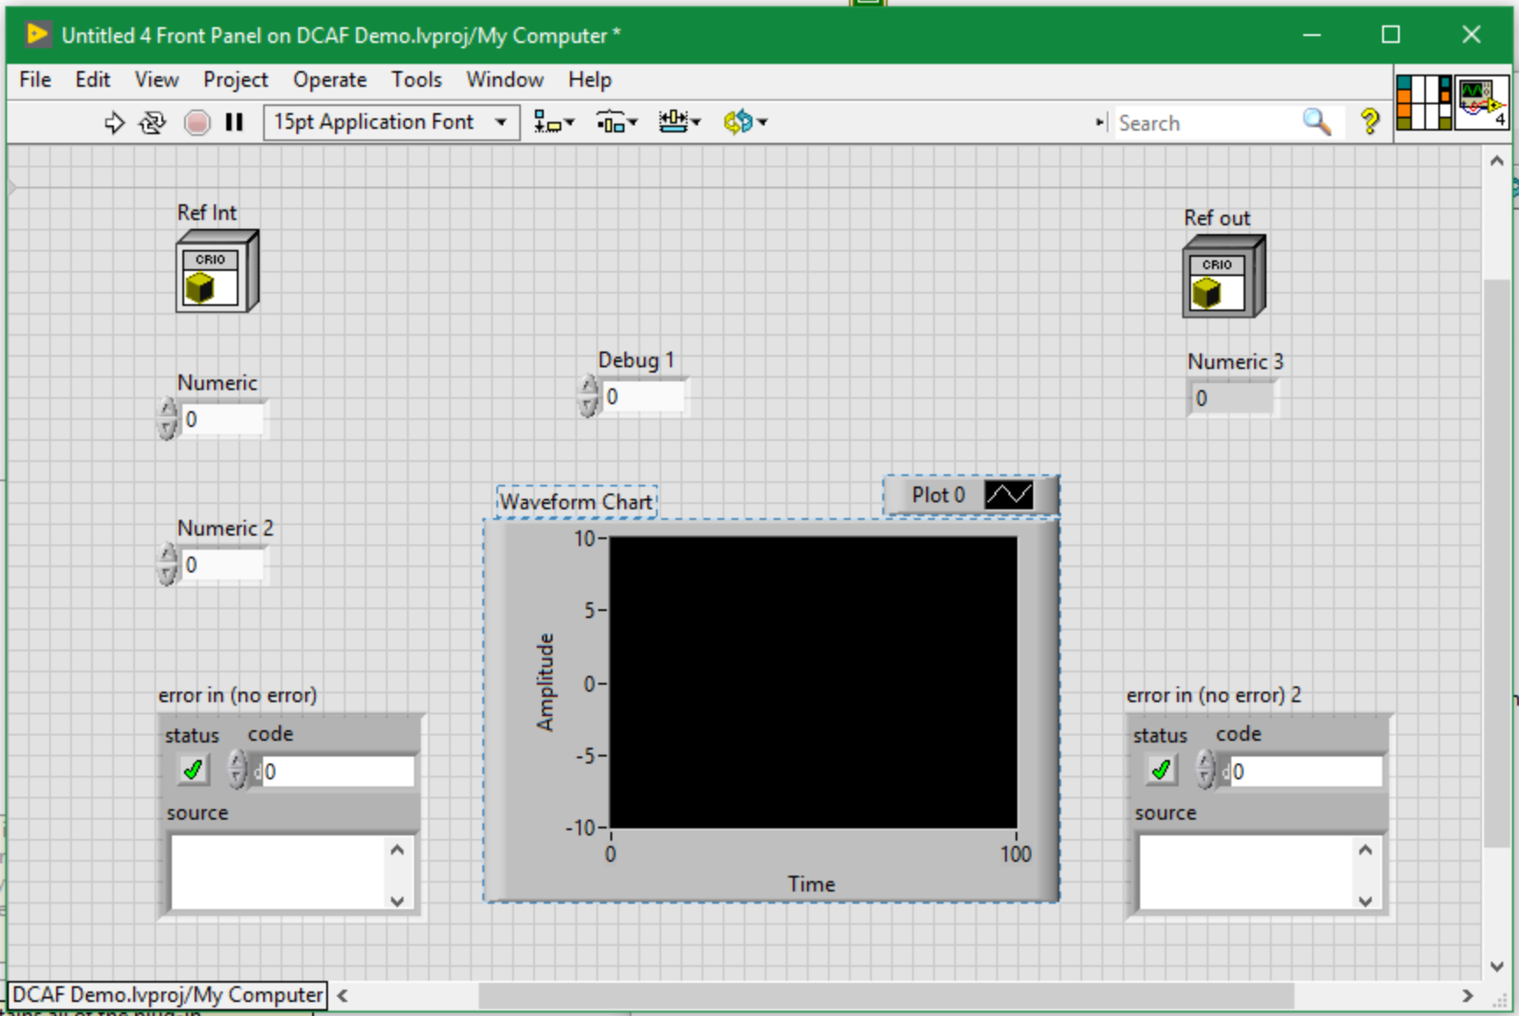
Front Panel Information

Slide 19
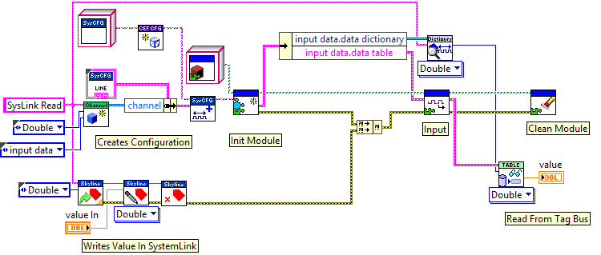
Code Stumps, Wrappers and Conditional disable

Slide 20
Unit Test
Unit Testing: Looking for errors in a subsystem in isolation.
You can NOT Test everything, so choose wisely.
You can NOT do proper testing without requirements
Testing adds overhead but reduces time spent in debugging.
You should do Unit Tests.
Make Time for testing.

Slide 21

Syslog
Available in Linux RT Targets
Event sent to Log:
Initialization and shutdown of all software modules
Any error reported to the engine
Any module trace messages added via the API

Slide 22
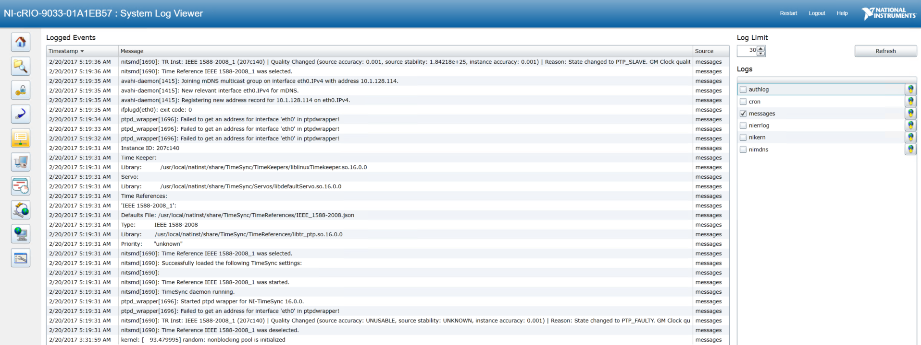
Syslog - System Log View

Slide 23
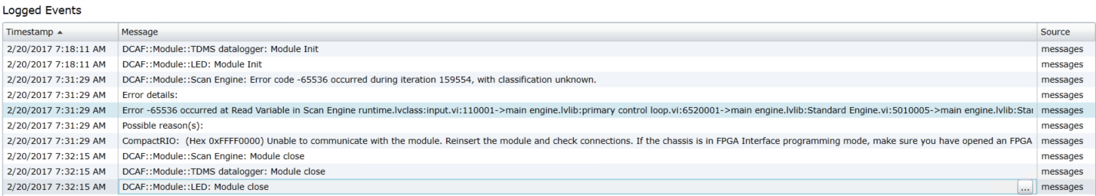
Syslog - System Log View

Slide 24
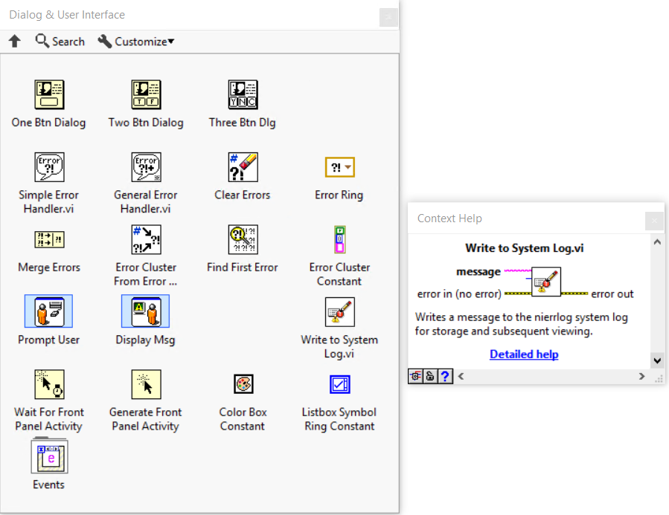
Syslog
NI Linux RT targets already have a syslog-ng daemon running
DCAF taps into the existing background process to log and report messages
You can, too!
Notes:
Add WIF

Slide 25
What is CVT
Current Value Table
Can be used as probe
Can be used to inject values

Slide 26
What is CVT with DCAF
Add CVT tags to the main VI
Make sure the name is correct (handle errors for the tags)

Slide 27
Shared Variables
Shared Variables have the limits but sometimes they can help debug RT applications
Use with care with Clones

Slide 28
Debugging Reentrant VIs

Slide 29
Reentrant clones.
Use breakpoints
Use no reentrant VIs (useful if you only have 1 instance)
Use syslog (but include clone information)
Non Reentrant SubVI

Slide 30
Conclusions
Use good practices to prevent bugs and make them easier to find
Consider what is causing the bug
Use unit test
Don’t rule out simple causes
Use all the different tools

Slide 31
CRIO Hardware
DCAF Scan Engine Module
DCAF UI Module
UI VI
DCAF Engine
DCAF Engine
DCAF UDP Module
UDP
DCAF UDP Module

